Slide 1
Computer Modeling and Simulation
Lecture 10-11

Slide 2
Simulation Techniques
Numerical Methods for solving ODEs
Euler’s Method,
Runge-Kutta 2
Runge-Kutta 4

Slide 3
Euler’s method
Consider an unconstrained growth model where
growth_rate = 0.10
population(0) = 100
growth(t) = growth_rate * population(t - Δt)
population(t) = population(t - Δt) + growth(t) * Δt
Starting with P₀ = P(0) = 100 and using Δt = 8. In the situation, t = 8, t − Δt = 0, growth(t) is the derivative at that time is Pʹ(0) = 0.1(100) = 10, which is the slope of the tangent line to the curve P(t) at (0,100).
We multiply Δt, 8, by this derivative at the previous time step, 10, to obtain the estimated change in P, 80.
Consequently, the estimate for P₁ is as follows:
estimate for P₁ = previous value of P + estimated change in P
= P₀ + Pʹ(0)Δt
= 100 + 10(8)
= 180

Slide 4
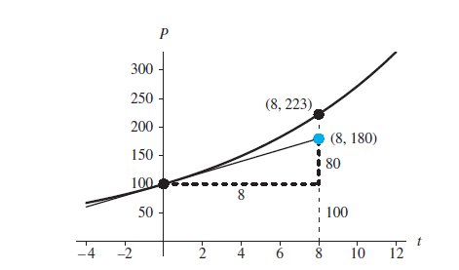
Actual point, (8, 223), and point obtained by Euler’s method, (8, 180)

Slide 5
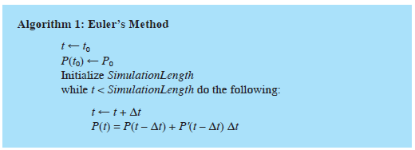
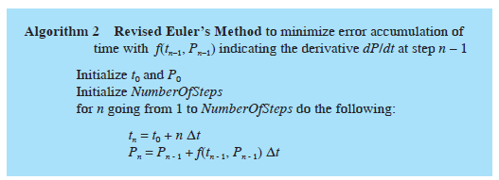
Euler’s Method Algorithm

Slide 6
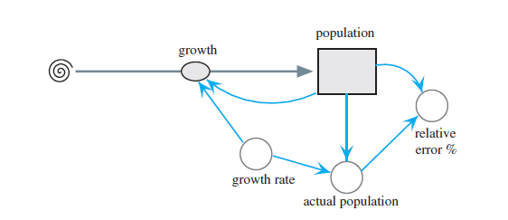
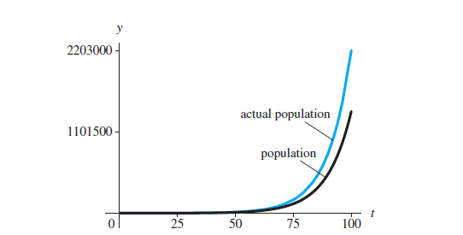
Error in Euler Method
Unconstrained growth model with monitoring
Graphs of analytical solution and Euler’s Method solution
with Δt = 1

Slide 7
Error in Euler Method
At time 100, the analytical value for the population is 2,202,647, while the simulated solution using Euler’s method produces 1,378,061, so that the relative error is more than 37.4%.
For Δt being cut in half, the relative error is almost cut in half to 21.5% at time 100.
If we cut the time step in half again so that Δt is 0.25, the relative also reduces by about half to 11.6% at time 100.
Thus, the relative error is proportional to Δt. We say that the relative error is on the order of Δt, O(Δt)

Slide 8
Runge-Kutta 2 Method
Also called Euler’s predictor-corrector (EPC)
In the first step, Euler method is used to predict the value of the function whose differential equation we wish to solve.

Slide 9
Euler’s Estimate as a Predictor
f(t_{n}, P_{n}) is sometimes a more convenient notation for the derivative dP/dt at Step n.
Thus, at (t, P) = (0, 100), the derivative is f(0, 100) = 0.1(100) = 10. According to that technique, using the derivative at (t_{n–1}, P_{n–1}), which is always equal to the slope of the tangent line there, we have the following computation for t_{n} and estimation of P_{n}:
t_{n} = t₀ + n Δt
P_{n} = P_{n–1} + f(t_{n–1}, P_{n–1}) Δt

Slide 10
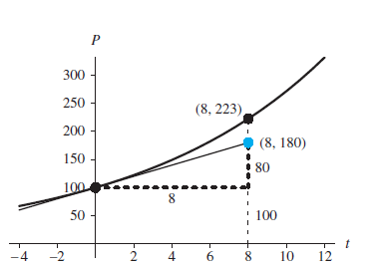
Actual point, (8, 223), and point obtained by Euler’s method, (8, 180)

Slide 11
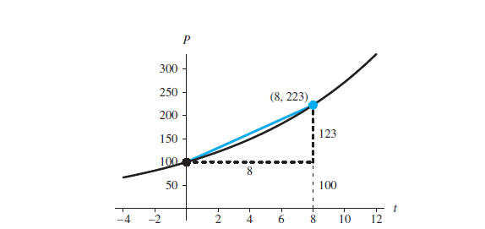
Corrector
To estimate (t_{n}, P_{n}), we would really like to use the slope of the chord from (t_{n–1}, P_{n–1}) to (t_{n}, P_{n}) instead of the slope of the tangent line at (t_{n–1}, P_{n–1}).
Actual point, (8, P(8)) ≈ (8, 223), along the chord between (0, 100) and (8,
223)

Slide 12
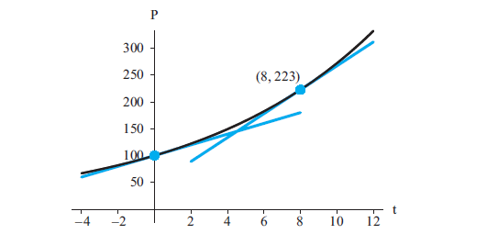
Corrector
Although we do not know the slope of the chord between (0, P(0)) and (8, P(8)), we can estimate it as approximately the average of the slopes of the tangent lines at P(0) and P(8):
slope of the chord b/w P(0) and P(8) = ( slope of tan at P(0))+ ((slope of tan at P(8))/2
Tangent lines at (0, P(0)) and (8, P(8))

Slide 13
Corrector
How can we find the slope of the tangent line at P(8) when we do not know P(8)?
Instead of using the exact value, which we do not know, we predict P(8) as in Euler’s
method.
As the computation in the first section, “Euler’s Estimate as a Predictor,” shows, in this case, the prediction is Y = 180. We use the point (8, 180) in derivative formula to obtain an estimate of slope at t = 8.
In this case, the slope of the tangent line at (8, 180), or the derivative, is f(8, 180) = 0.1(180) = 18.
Using 18 as the approximate slope of the tangent line at (8, P(8)), we estimate the slope of chord between (0, P(0)) and (8, P(8)) as the following average of tangent line slopes:
slope of chord ≈ (10 + 18)/2 = 0.5(10 + 18) = 14
Using 14, the corrected estimate is P1 = 100 + 14*8 = 212

Slide 14
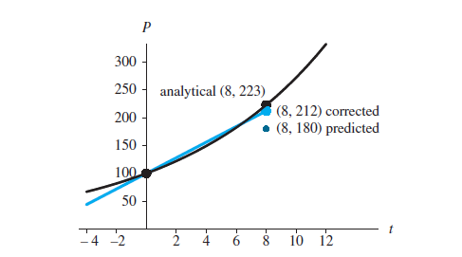
RK-2 Method
Predicted and corrected estimation of (8, P(8))

Slide 15
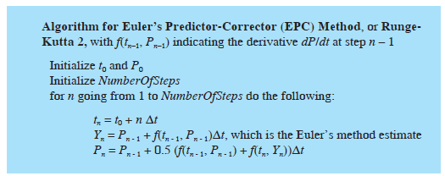
RK-2 Algorithm

Slide 16
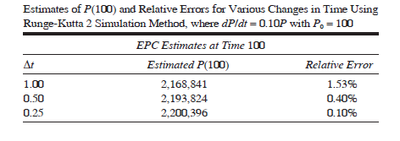
Error in RK-2 Method

Slide 17
Runge-Kutta 4
Of the three integration techniques —Euler’s, Runge-Kutta 2, and Runge-Kutta 4 methods—the last is the most involved but the most accurate.
The relative errors of the techniques are O(Δt), O(Δt²), and O(Δt⁴), respectively, with the names Runge-Kutta 2 and 4 indicating the exponents of Δt. Thus, the latter technique improves the most as Δt gets smaller.
To illustrate Runge-Kutta 4 method, we use the example f(t, P) = dP/dt = 0.10P, with P₀ = 100 and Δt = 8, to show the derivation of P₁ from P₀.
To estimate P_{n}, the technique adds to P_{n–1} a weighted average of four estimates—∂1, ∂2, ∂3,and ∂4—of the change in P

Slide 19
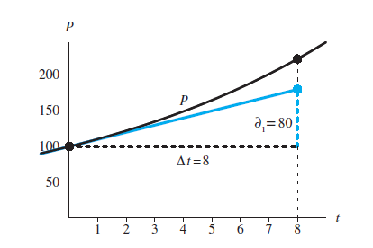
First Estimate, ∂1, Using Euler’s Method
In general, the first estimate of ΔP = P_{n} – P_{n-1} is as follows:
∂1 = f(tn–1, Pn–1)Δt
First estimate of change in P, ∂1 = 80

Slide 20
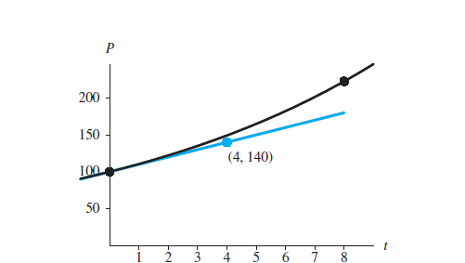
Second Estimate, ∂2
To calculate the second estimate of ΔP for the previous example, we use the point halfway between the initial point (t0, P0), and point from Euler’s estimate, (t₀ + Δt,P₀ + ∂1), in the figure below.
The midpoint is on the tangent line to the graph of the function P at (t₀, P₀) = (0, 100). Its first coordinate is t₀ + 0.5Δt = 0 + 0.5(8) = 4, and its second coordinate is P₀ + 0.5∂1 = 100 + 0.5(80) = 140. Figure below depicts this point
Midpoint (4, 140) between (t0, P0) = (0, 100) and (t0 + Δt, P0 + ∂1) = (8, 180)

Slide 21
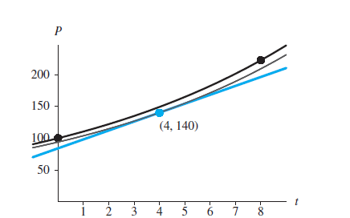
Second Estimate, ∂2
We calculate the derivative, f, for this midpoint using the derivative formula f(t,P) = 0.1P, as follows:
f(4, 140) = 0.1(140) = 14
Figure below shows, with less thickness, the exponential function through (4, 140) that has derivative 14 at t = 4. Thus, at t = 4 the curve’s tangent line, which is in color, has slope 14
Estimate slope at midpoint between (0, 100) and (8, 180)

Slide 22
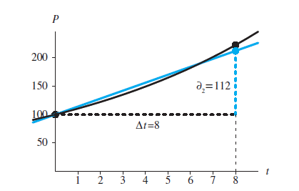
Second Estimate, ∂2
For the second estimate of the change in P, ∂2, we determine the change in the vertical direction for this line for Δt = 8, as follows:
∂2 = ((0.1)(140)) (8) = 14 (8) = 112
Figure below pictures a line of the same slope (14) that passes through the initial point (0, 100). After a change in t of 8 units, P
Second estimate of change in P, ∂2 = 112

Slide 23
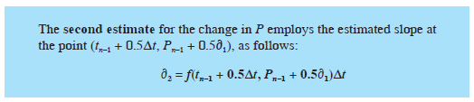
Second Estimate, ∂2

Slide 24
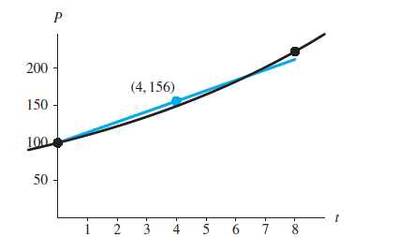
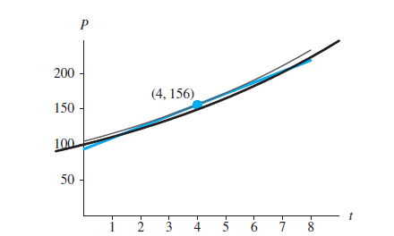
Third Estimate, ∂3
For the third estimate, ∂3, we use the same process as for the second estimate on the line that passes through the initial point (0, 100) and the second estimate point, (t + Δt, P₀ + ∂2) = (8, 212).
First, we find the midpoint, (4, 156), between the endpoints.
Using the derivative formula, f(t, P) = 0.1P, we estimate the slope of the curve at t = 4 as f(4, 156) = 0.1(156) = 15.6. The line through (4, 156) with slope 15.6 appears in color in
Midpoint (4, 156) between (t0, P0) = (0, 100) and
(t0 + Δt, P0 + ∂2) = (8, 212)
Estimate slope at midpoint between (0, 100) and (8, 212)

Slide 25
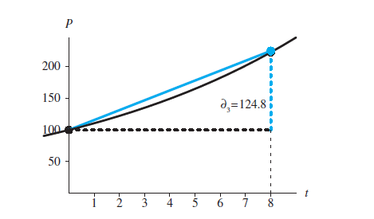
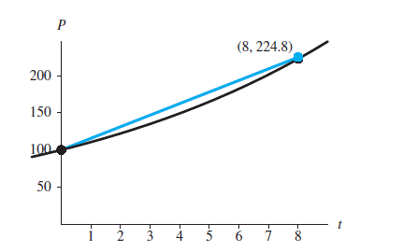
Third Estimate, ∂3
Using the slope of this line, we determine the third estimated change in P over Δt = 8, ∂3, as follows:
∂3 = ((0.1)(156)) (8) = 15.6 (8) = 124.8
Figure below displays this third estimate of ΔP, ∂3, as the length of the colored, vertical dashed line to the point, (8, 224.8), both of which are in color.
Third estimate of change in P, ∂3 = 124.8
Endpoint (t0 + Δt, P0 + ∂3) = (8, 224.8)

Slide 26
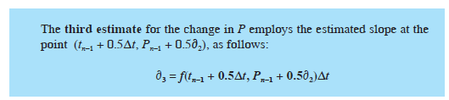
Third Estimate, ∂3

Slide 27
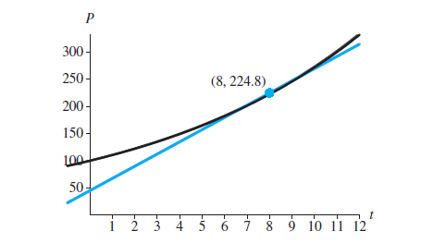
Fourth Estimate, ∂4
The fourth estimate, ∂4, of the change in P over the interval of length Δt occurs at the end of the interval.
Using the third estimate ∂3, the endpoint is (t₀ + Δt, P₀ + ∂3) = (8, 224.8) for the example under discussion.
With dP/dt = f(t, P) = 0.1P, The following computation estimates the slope at the endpoint: f(8, 224.8) = 0.1(224.8) = 22.48
Below figure shows the endpoint along with the exponential function and tangent line of slope 22.48 through that point.
Estimate slope at (8, 224.8)

Slide 28
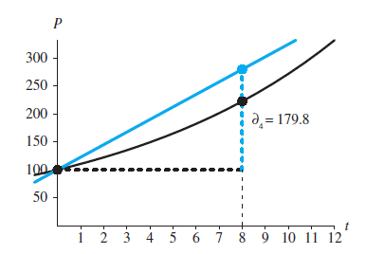
Fourth Estimate, ∂4
With this slope, we estimate ∂4, the increase in P as t increases, by Δt = 8, as follows:
∂4 = ((0.1)(224.8))(8) = 22.48(8) = 179.84
This fourth estimate of ΔP is the length of the boldfaced, vertical dashed line to the point (8, 279.84), both of which are in color in the below figure. Using ∂4, 279.84 is the new estimate of P1.
Fourth estimate of change in P, ∂4 = 179.84

Slide 29
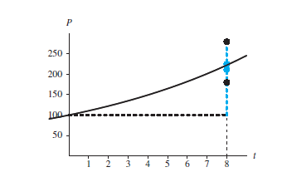
Four estimates of RK 4 method
Four estimates of ΔP

Slide 30

Using the four estimates
To determine the Runge-Kutta 4 estimate of P1, we add to P0 = 100 a weighted average of ∂1, ∂2, ∂3, and ∂4. Giving twice the weight to the estimates at the midpoint, the computation is as follows:
P₁ = P₀ + (∂1 + 2∂2 + 2∂3 + ∂4)/6
= 100 + (80 + 2 ∙ 112 + 2 ∙ 124.8 + 179.84)/6
= 100 + 122.24
= 222.24

Slide 31
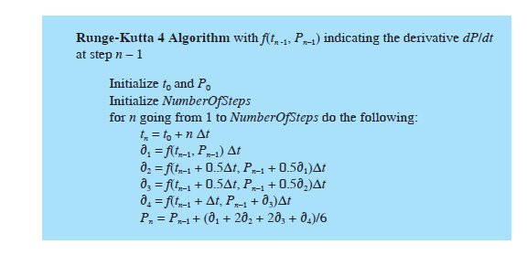
Runge-Kutta 4 Algorithm

Slide 32
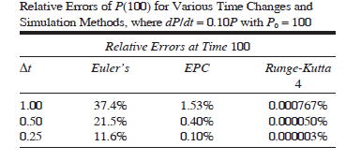
Error

